Slide 1
Computational Linguistics
:
Lecture 1. Introduction
Notes:
Mention collaborators!

Slide 2
Sources
Slides from:
Felipe Bravo-Marquez: https://github.com/dccuchile/CC6205/
Suzan Verberbe: http://tmr.liacs.nl/TM.html

Slide 3
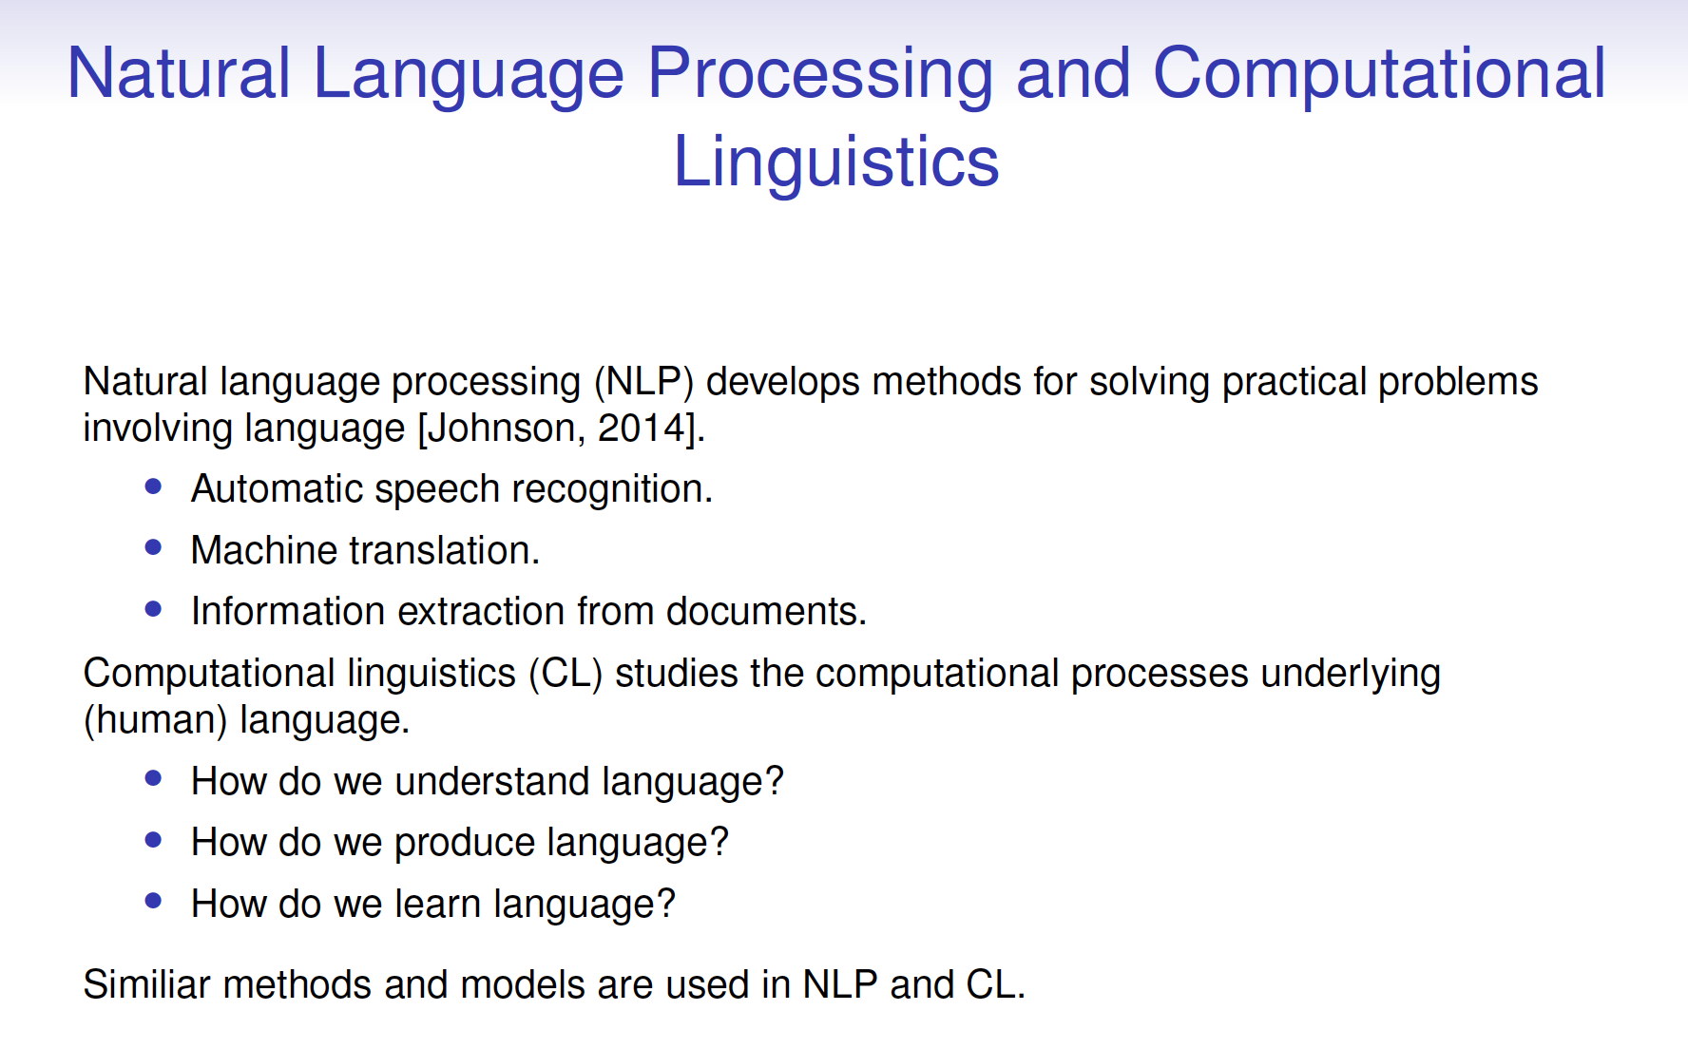
Who are you?
Quick round (raise hands)
Who has taken a course in Data Mining or Machine Learning?
Who is has taken a course in Information Retrieval?
Who can program in Python?
Who knows what the vector space model is?
Who could explain the difference between supervised and unsupervised learning?
Who has experience with deep neural networks?
Who knows what Precision and Recall is?
Who knows what a noun phrase is?

Slide 4
After this lecture…
You can explain the relation between text mining and data mining
You can list and explain the most important challenges of text data
You can describe the text mining process on a high level
You can explain the difference between tasks that represent text as classification object and tasks that represent text as sequence

Slide 5
Why NLP

Slide 6
Abundance of Text data
Think of:
web pages
user-generated content on the web
social media messages
electronic health records
scientific literature
patents
political/legal texts

Slide 7

Let’s start with a case
Goal: to discover side effects for hypertension medications
Data:
1M electronic health records
9,892 messages from a patient discussion forum on hypertension
How would you address this problem? Discuss in groups of 2, make brief notes/a drawing

Slide 8
What did you come up with?
Which data do you use?
Filter the data?
Process the data?
Identify medication names? External knowledge needed?
Identify side aspects? Relations between medications and side effects?
Combine the data sources?
What human input would you need?

Slide 9
Text mining

Slide 10
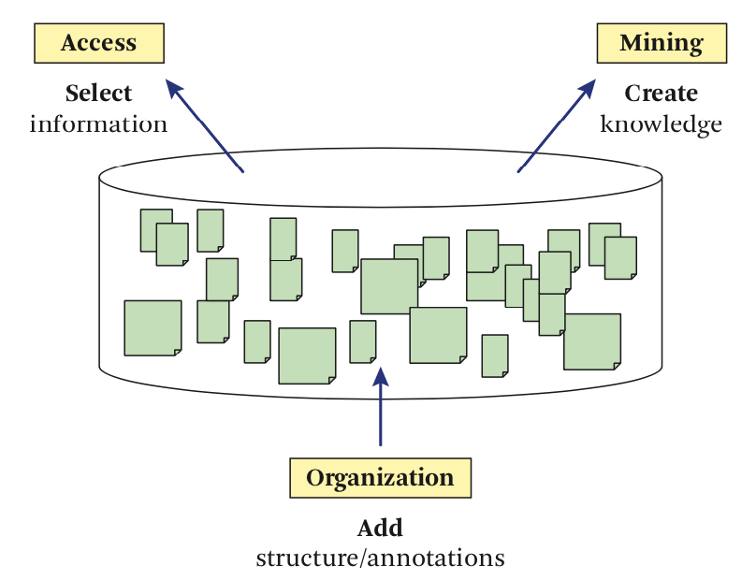
What is Text Mining
Text mining: Automatic extraction of knowledge from text
Text = unstructured
Knowledge = structured
Zhai & Massung, fig 1.2

Slide 11
Text mining and data mining
Text mining is a form of data mining
Many of the learning methods are similar
Classification
Clustering
But text data is unstructured
And requires text-specific processing
We will see the specifics of text data later

Slide 12
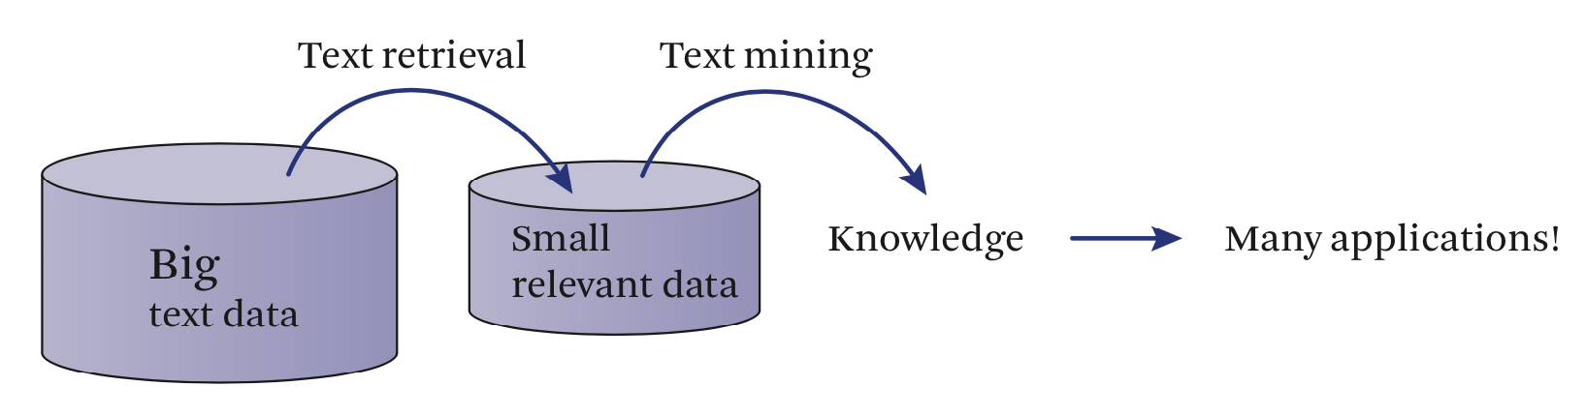
Text Mining and Information Retrieval
Text Mining (TM) and Information Retrieval (IR) are related disciplines
In many applications, IR is the first step of the TM process
First retrieve documents (IR), then extract and structure the relevant information
Zhai & Massung, fig 1.1

Slide 13
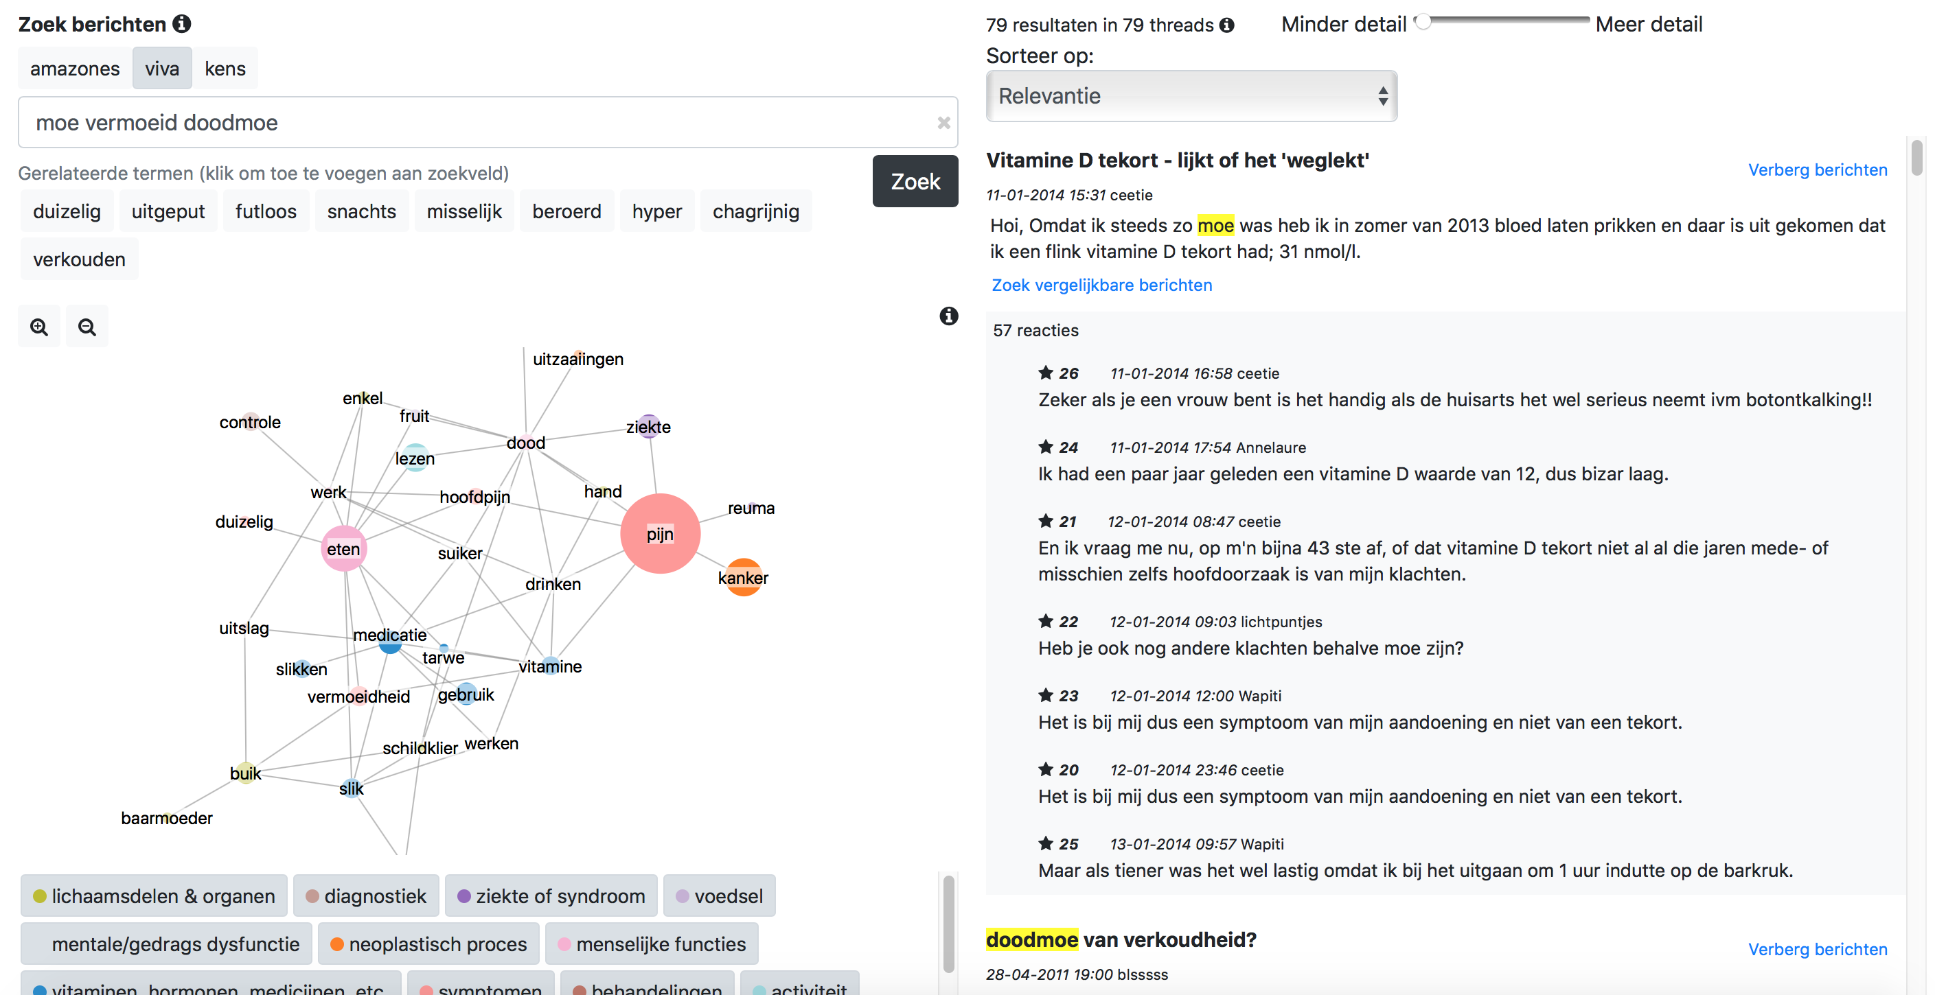
Text mining as advanced search

Slide 14
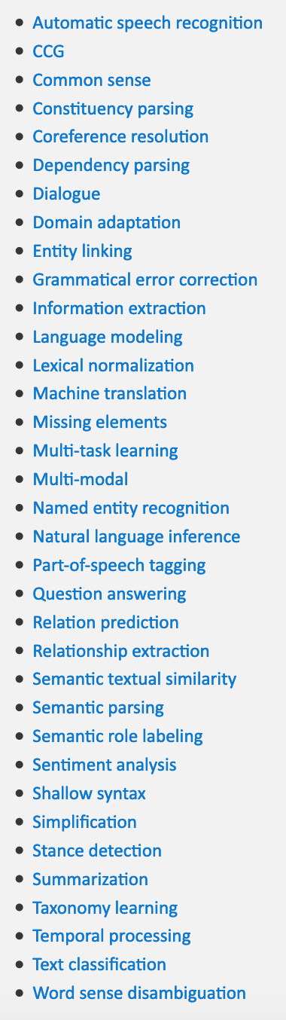
Text Mining and NLP
NLP = Natural Language Processing
Text Mining applications use NLP methods for information extraction
NLP is a large and active research field
Not all NLP tasks are TM tasks
e.g. Machine translation, Speech recognition
Check http://nlpprogress.com/ for an overview of NLP tasks and the state-of-the-art methods for each task

Slide 15
The text mining pipelinE
1. Retrieve documents from collection
2. Pre-process documents
3. Extract structured information
Example TM problem: discover side effects for hypertension medications
IR: retrieve documents (health records, forum posts) that mention hypertension medication
Pre-processing: Split the documents in sections, sentences, words. Clean from noise
NLP: extract the medication names and side effects

Slide 16
Types of Text processing tasks
Roughly, we distinguish three types of text mining tasks:
Text classification/clustering: assign a category or cluster per document
the ‘document’ can be any text type (newspaper article, tweet, e-mail, text message, patent, …)
the ‘category’ can be any type of label (topic, relevance indicator, author, sentiment, …)
Sequence labelling: assign a category per word in a text
e.g. label the person names, dates and places in a text (named entity recognition)
Text-to-text generation: input is text, output is text
summarization, translation

Slide 17
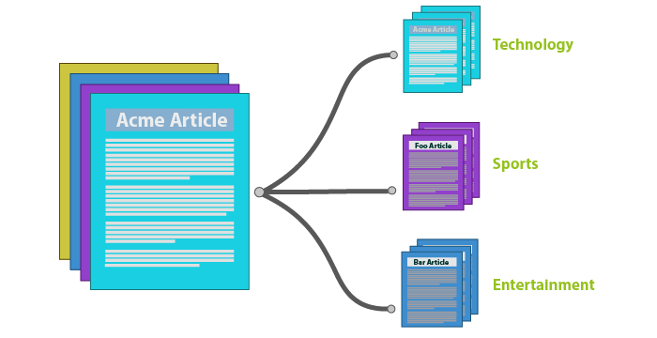
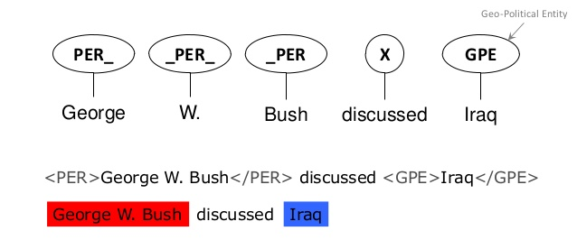
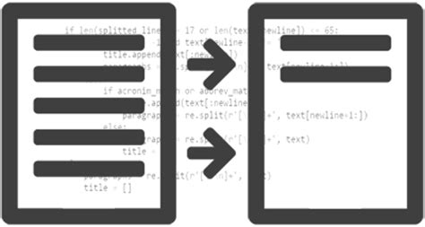
Text classification
Named entity recognition (= sequence labelling)
Summarization (= sequence-to-sequence)

Slide 18
Challenges of text data

Slide 19
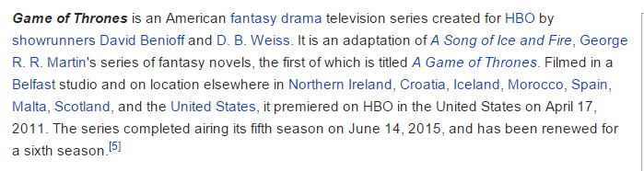
1. Text data is unstructured
Or at best semi-structured:
PHYSICAL EXAMINATION: On physical examination, her blood pressure was 104/73, pulse 79. In general, she was a woman in no acute distress. HEENT: Nonicteric. Pupils are equal, round, and reactive to light. Extraocular movements are full. Pharynx is benign. Tongue midline. Neck is supple.

Slide 20

2. Text data can be multi-lingual

Slide 21
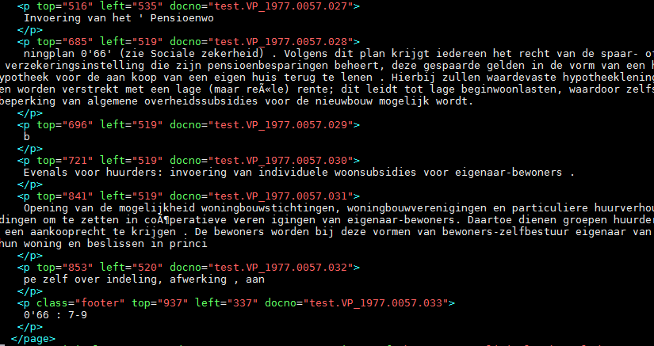
3. Text data is noisy
Noisy encoding and typography might give challenges in processing
Noisy attributes: spelling errors, OCR errors

Slide 22
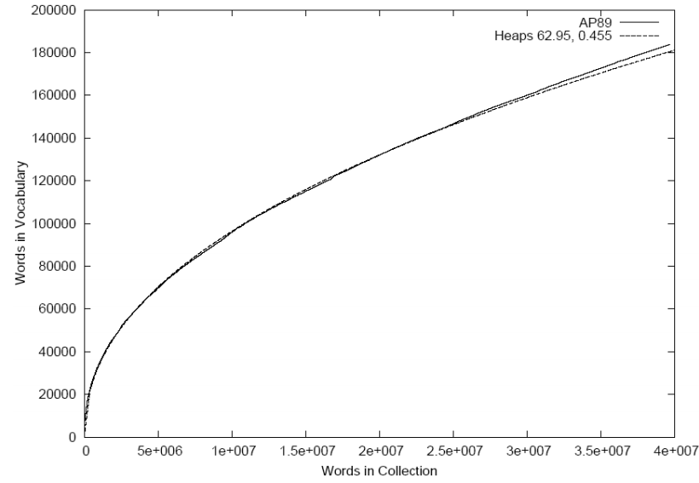
4. Language is infinite
A new document in your collection is likely to add new terms → new dimensions
The number of new words will increase very rapidly when the corpus is small and would continue to increase indefinitely, but at a slower rate for larger corpus (Heaps’ Law)
Notes:
http://www.cs.sfu.ca/CourseCentral/456/jpei/web%20slides/L06%20-%20Text%20statistics.pdf

Slide 23
5. Text data is sparse
Important distinction here: Text as classification object vs. text as sequence
As classification object, text is sparse

Slide 24
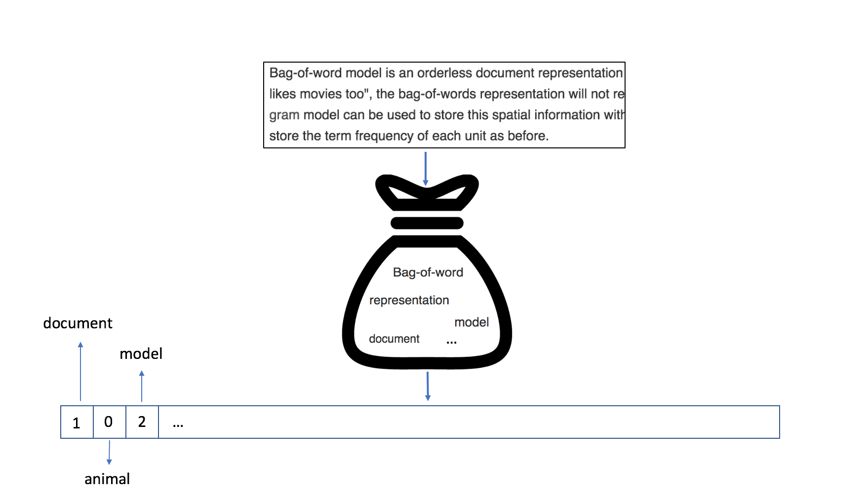
Text as classification object
When we are classifying documents (in topical categories, authors, sentiment labels, etc), we represent the text as a ‘bag of words’

Slide 25
Text as classification object
Traditional Bag-of-words model:
Word order is not relevant
Punctuation is not relevant
Sentence and paragraph borders are not relevant
vector representation
Notes:
Slide 29: Bij al de punten zijn uitzonderingen te bedenken, word order is enigszins relevant als je ngrams gebruikt. Punctuation kan zeer relevant zijn in tweets. Je kunt sentence/paragraph borders relevant maken als je een sentence/paragraaf beschouwt als document. (Wellicht zit hier een opdracht/tentamenvraag in?

Slide 26
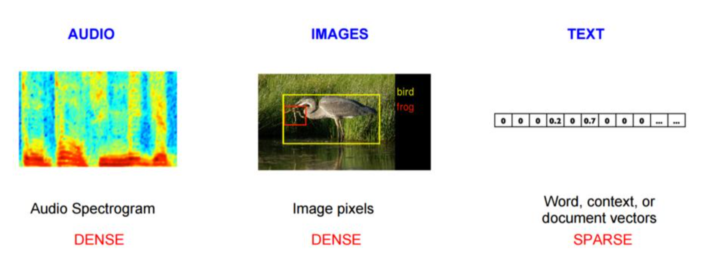
Text as classification object
Typically, we use words as features in text classification
Only a few of all words occur in a given document
Hence, text vectors are sparse vectors

Slide 27
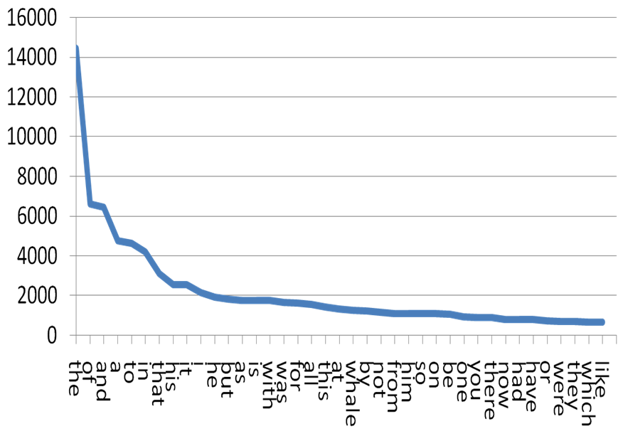
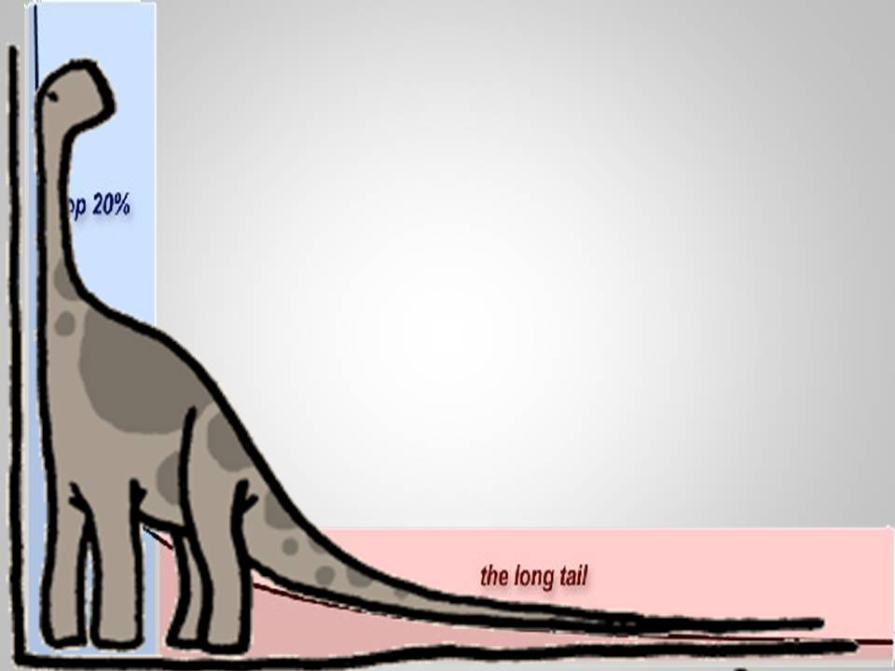
Zipf's law
Given a text collection, the frequency of any word is inversely proportional to its rank in the frequency table
In English, the top four most frequent words are about 10-15% of all word occurrences. The top 50 words are 35-40% of word occurrences.
Notes:
Zipf's law states that given some natural language corpus, the frequency of any word is inversely proportional to its rank in the frequency table.
In other words: the most frequent word will occur twice as often as the second most frequent word, three times as often as the third most frequent word, etc.

Slide 28
5. Text data is sparse
Important distinction here: Text as classification object vs. text as sequence
As classification object, text is sparse

Slide 29
Text as sequence
If we want to extract knowledge from text, word order, punctuation and capitalisation do matter
E.g. extract birth dates and birth places from text:
Carel Jan Jozef Marie Stolker (Leiden, 23 June 1954) is a Dutch administrator and the rector magnificus and president of Leiden University as of February 2013. He is the successor of Paul F. van der Heijden.^{[1]} Stolker is a professor of private law and former dean of the Leiden University Law School (2005-2011).

Slide 30
Evaluation

Slide 31
Evaluation of text mining
Evaluation of complete application (extrinsic evaluation):
human vs. automatic
are humans helped/satisfied by the results?
Evaluation of the components (intrinsic evaluation): ground truth labels needed
Existing labels in the data
Human-assigned labels in the data
Notes:
Who can define precision, recall and accuracy

Slide 32
Evaluation of text mining
Evaluation metrics:
accuracy
precision
recall
precision: proportion of the assigned labels that are correct
recall: proportion of the relevant labels that were assigned

Slide 33
Precision and recall
A = set of labels assigned by algorithm
T = set of true labels
This will come back in many lectures (with specific definitions for each task)

Slide 34
Precision and recall example
Think of spam classification as example task: messages are classified as either spam or no-spam
We can measure accurracy: what proportion of messages is correctly labeled.
But there are two ways the label can be wrong:
a spam message ends up in the inbox
a non-spam message ends up in the spambox
Precision and Recall measure these 2 evaluation aspects
precision of the ‘spam class’: what proportion of the messages in the spam box were indeed spam
recall of the ‘spam class’: what proportion of the true spam messages were correctly put in the spam box

